Slide 1
Chapter 5
Ethernet
Module 7: Ethernet Switching
Introduction to Networks v7.0 (ITN)

Slide 2
Objectives
5.1 Ethernet Protocol
5.2 LAN Switches
5.3 Address Resolution Protocol (ARP)

Slide 3
Basic Terms
LAN
A computer network that spans a relatively small area
Physical topology
The physical layout (arrangement) of devices on a
network
Logical topology
The way data passes through the media from one device
to the next regardless to the physical topology

Slide 4
Cont’d…
Hub
Layer 1 device that used to connect devices in a network.
When a packet arrives , hub simply broadcast to all
others (all can “see”)
Switch
Layer 2 device that is used to filter and forward data. Switch
first broadcast; then unicast & multicast as needed.
MAC address
a hardware address (physical address) that uniquely identifies
each node of a network

Slide 5
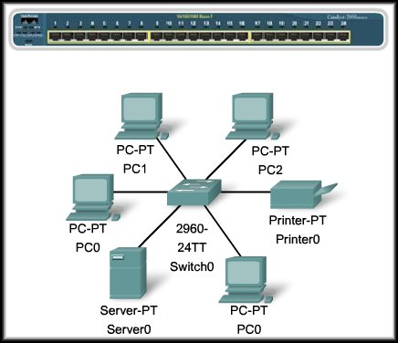
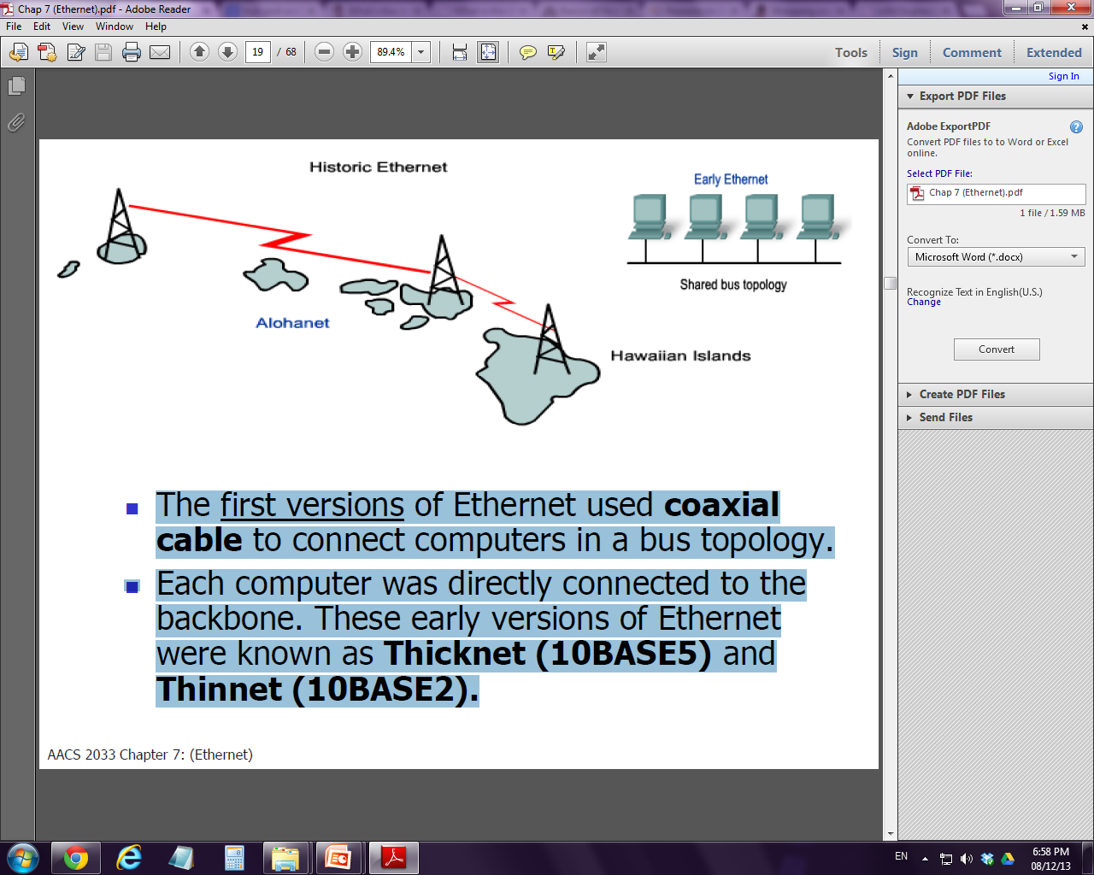

5.1 Ethernet Protocols
Overview of Ethernet
The most widely used wired LAN technology / standard (token ring, FDDI, ARCNET) why ?
Generally appears in the form of physical bus / star with logical bus topology access method (contention-based method)
Uses CSMA/CD for media access (CSMA/CD network)

Slide 6
Cont’d…
Typically uses coaxial cable and special grades twisted pair wires
Different variations (support different bandwidth):
10 Mbps → 10BASE-T
100Mbps → 100BASE-T, Fast Ethernet
1000 Mbps → Gigabit Ethernet
10,000 Mbps →10-Gigabit Ethernet

Slide 7
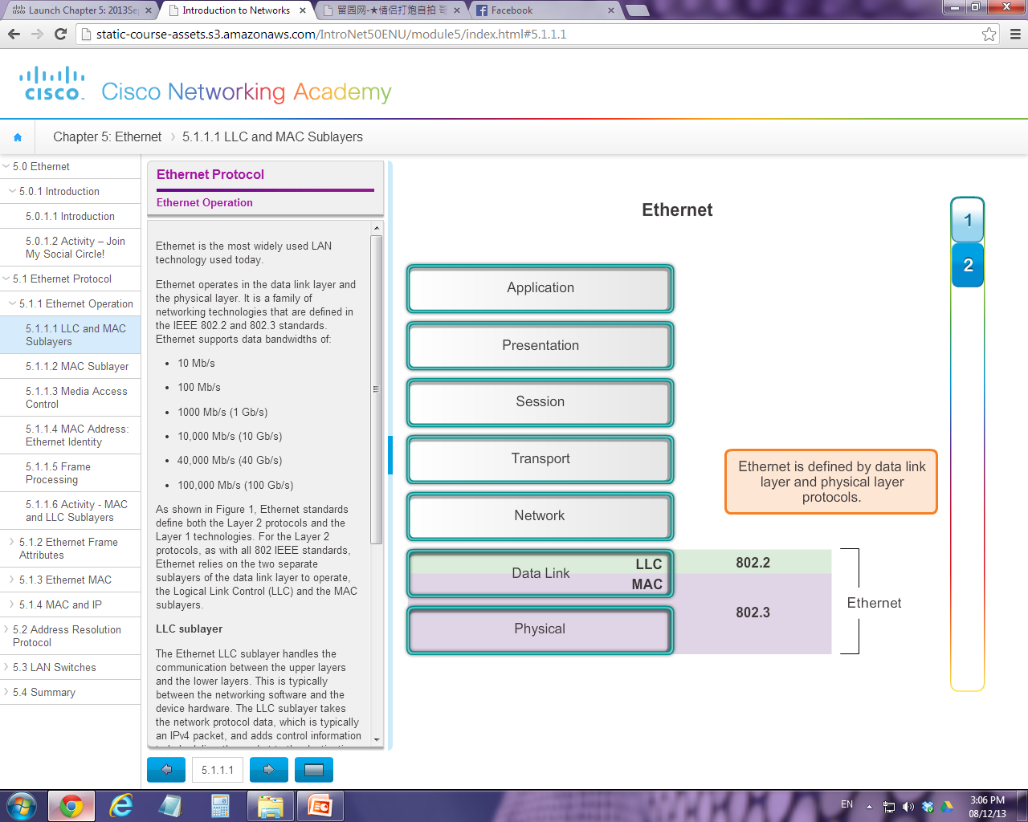
Cont’d…
Ethernet standard covers:
Data Link Layer Protocols
Physical Layer Technologies

Slide 8
Physical Layer
Ethernet at Layer 1 involves bit streams, encoding, signalling and placing signal on media, as well as various network topologies and hardware specifications
Ethernet Layer 1 alone is not sufficient to describe a LAN technology hence Layer 2 is involved too.

Slide 9
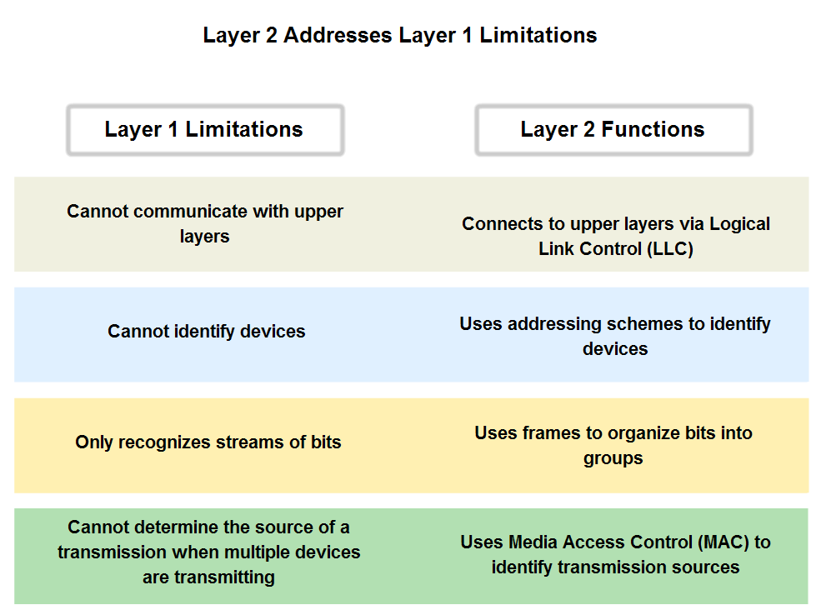

Slide 10
Data Link Layer
LLC sublayer (IEEE802.2)
Interfacing the upper layers and the lower layers ie. networking software and the device hardware
Adds control information and assists in creating frames (from packet) for the lower layers for delivery.
In computer, LLC can be considered as driver software for the NIC

Slide 11
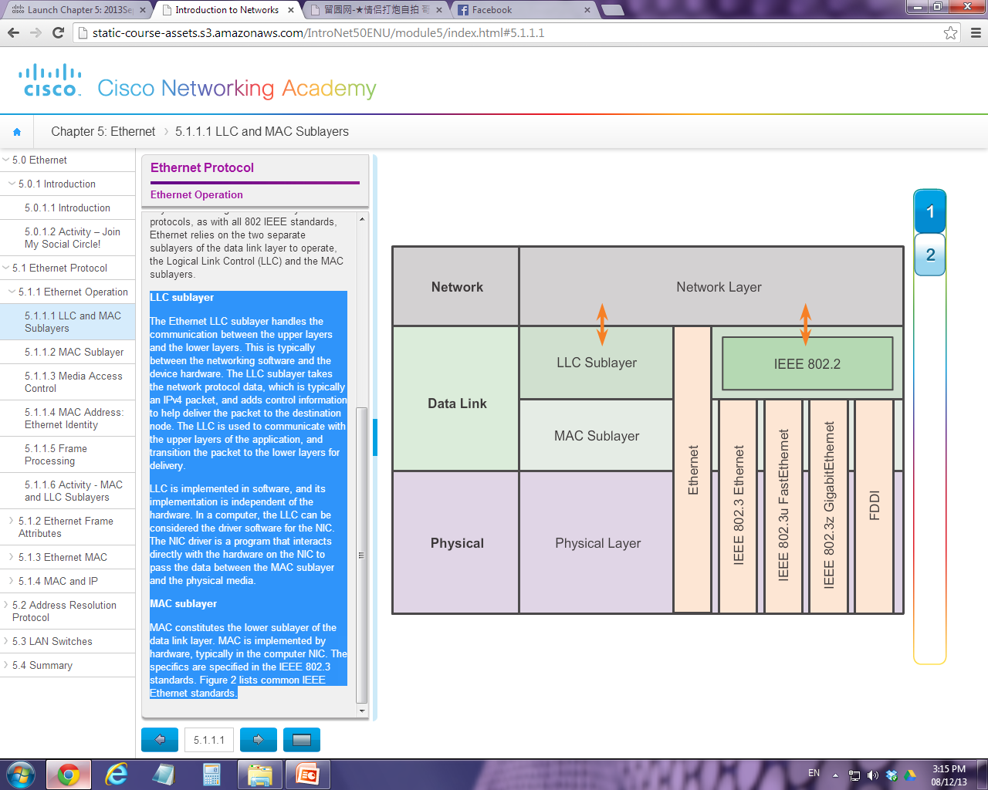

Slide 12
Cont’d..
MAC sublayer (IEEE802.3)
MAC sublayer deals with media access control methods and functions with Physical Layer
Media Access Control is implemented by hardware, typically in the computer Network Interface Card (NIC).
Ethernet MAC sublayer has two primary responsibilities:
Data encapsulation
Media access control

Slide 13
Cont’d…
Data Encapsulation
Data Encapsulation → adding header and trailer to the packet
It involves the following 3 processes:
Frame delimiting (boundaries)
→ provide start-of-frame and end-of-frame bits so to make up a frame for transmission
Addressing
→ to include MAC address to the header
Error detection
→ to include CRC value in FCS field for error checking purpose

Slide 14
Cont’d…
Media access control
Media access control → to put / retrieve frame on the media (control the placement / retrieval of frame on media)
This sublayer communicates directly with the physical layer
The underlying logical topology for original Ethernet is:
Multi-access bus topology
All nodes are sharing single
transmission medium
Contention-based (non-deterministic)
network
CSMA/CD

Slide 15
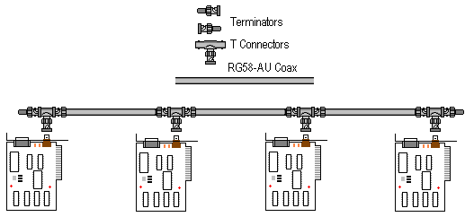
Brief History of Ethernet
The first version of Ethernet used coaxial cable to connect computers in a bus topology, known as Thicknet (10BASE5) and Thinnet (10BASE2) → 10 Mbps speed

Slide 16
Cont’d…
Later the coaxial cables were replaced with twisted pair and fiber optic links in conjunction with hubs and switches.
Hub-based Ethernet and Switch-based Ethernet
The physical topology was also changed to a star topology from bus topology
Data rates were also increased from 10Mbps → 1000Mbps (10Base-T, Fast Ethernet, Gigabit Ethernet)

Slide 17
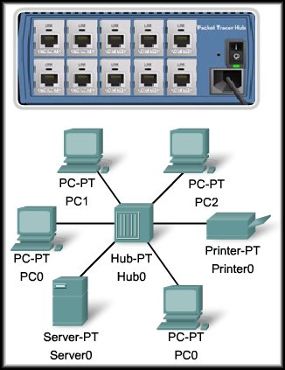
Hub-based Ethernet (Legacy Ethernet)
In the hub-based Ethernet, devices are connected using hub
Transmission mode: Half-duplex communication
Hub broadcasts the data to everyone and only the receiver will accept (examine the MAC address)
Collision is possible and is handled using CSMA/CD

Slide 18
Switch-based Ethernet
In the switch-based Ethernet, devices are connected using switch
Transmission mode: Full-duplex communication
Switch first broadcasts the data to everyone and learn the receiver then unicast / multicast as needed
Collision does not occur

Slide 19
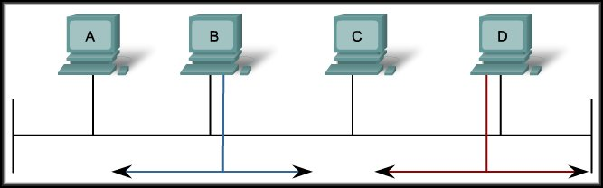
CSMA/CD – how it works?
- extensively used in the early Ethernet technology or LANs.
- no longer used in modern Ethernet networks as they are designed with switches
and full-duplex connections.

Slide 20
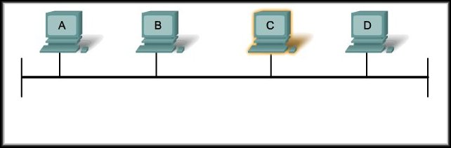
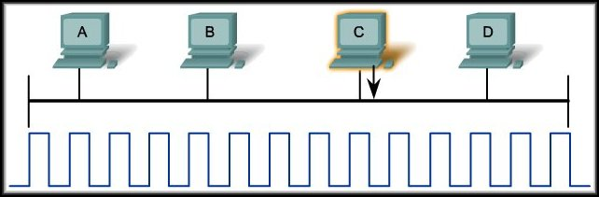
To transmit, each host will listen on the media.
If a signal from another device is present, it will wait for a specific amount of time and listen again.
If no signal is present, it will transmit.

Slide 21
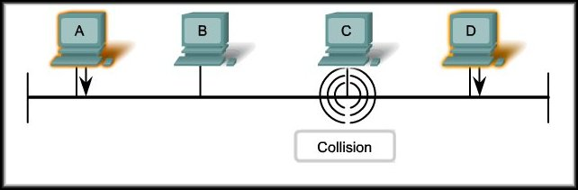
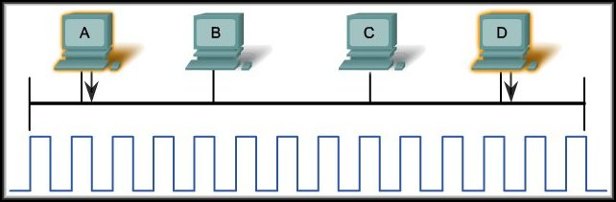
It can happen that two devices will determine that it is safe to transmit at exactly the same time.
In that case, both will transmit their frame.
Collision!

Slide 22
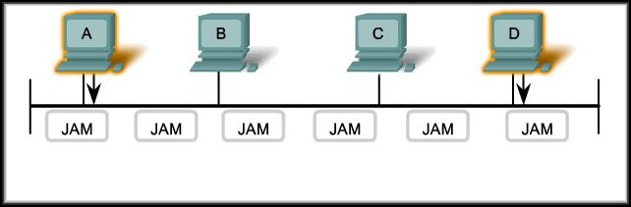
Both devices detect the collision and send out a jamming signal.
The jamming signal is detected by all devices and all devices now know that a collision has occurred on the network.

Slide 23
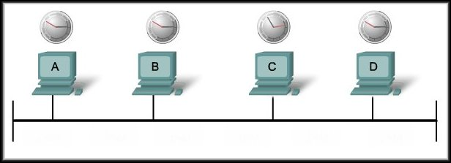
CSMA/CD: The Process
The jamming signal causes each device to invoke a backoff algorithm.
Devices wait a random amount of time before returning to listening mode.
The random time ensures that the original devices that caused the collision won’t repeat it.

Slide 24
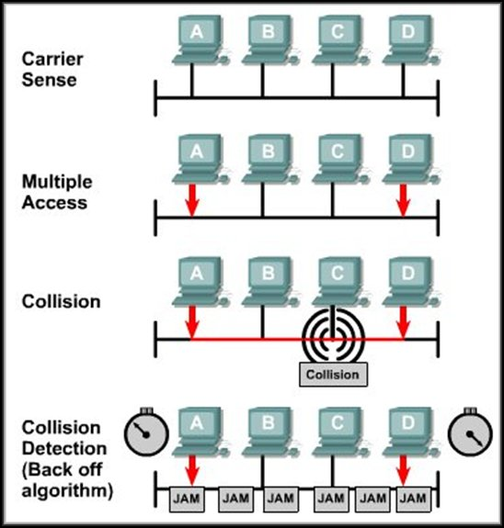

Slide 25
5.1.1 Ethernet Frame
Ethernet II is the Ethernet frame format used in TCP/IP networks.
The Ethernet standard frame has a minimum frame size of 64 bytes and the maximum of 1518 bytes
If the size of a transmitted frame is not within the range, the receiver will drop the frame
“collision fragment” or “runt frame” vs
“jumbo” or “baby giant frames”

Slide 26
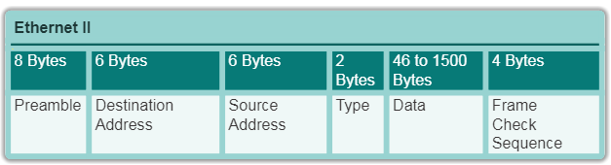
Cont’d…
Revised IEEE 802.3 (Ethernet II) Frame
min: 6+6+2+46+4 =64 bytes (not inclusive Preamble field)
max: 6+6+2+1500+4 =1518 bytes (not inclusive Preamble field)

Slide 27
Frame Fields
Preamble and Start Frame Delimiter Fields (8 bytes)
used for synchronization between the sender and receiver
used to get the attention of the receiver (a frame is coming)
Destination MAC Address Field (6 bytes)
Serves as the identifier for the intended recipient.
Source MAC Address Field (6 bytes)
Serves as the identifier for original sender

Slide 28
Cont’d…
Length / Type Field (2 bytes)
Indicates length of Data Field OR
Describe which higher-layer protocol is present.
Data Field (46 - 1500 bytes)
Contains the encapsulated data (Packet) from a higher layer, Network Layer
Frame Check Sequence Field (4 bytes)
Consist of CRC which is used to detect errors in a frame.

Slide 29
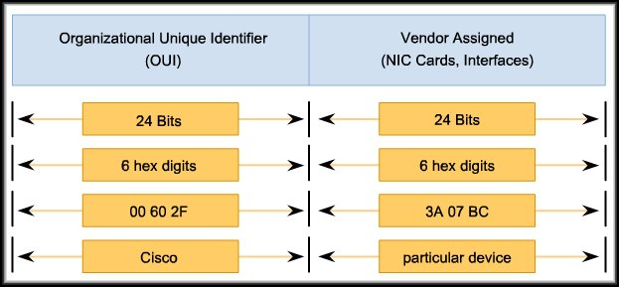
5.1.2 Ethernet MAC address
48-bit in physical address and represented in 12 HEX digits
The first 6 HEX identify the manufacturer or vendor
The remaining 6 HEX comprise the interface serial number which is unique

Slide 30
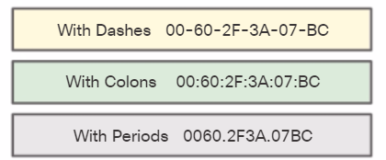
Cont’d…
A.k.a. burned-in address (BIA) because it is permanently burned into ROM (Read-Only Memory) on the NIC.
Vendor code
Device serial number

Slide 31
Some important points about MAC add.
MAC addresses are non-hierarchical.
They have no meaning outside the local network media.
MAC address is used only in local network only
Network (IP) Address is required (by the Router) to forward packets to other destination networks

Slide 32
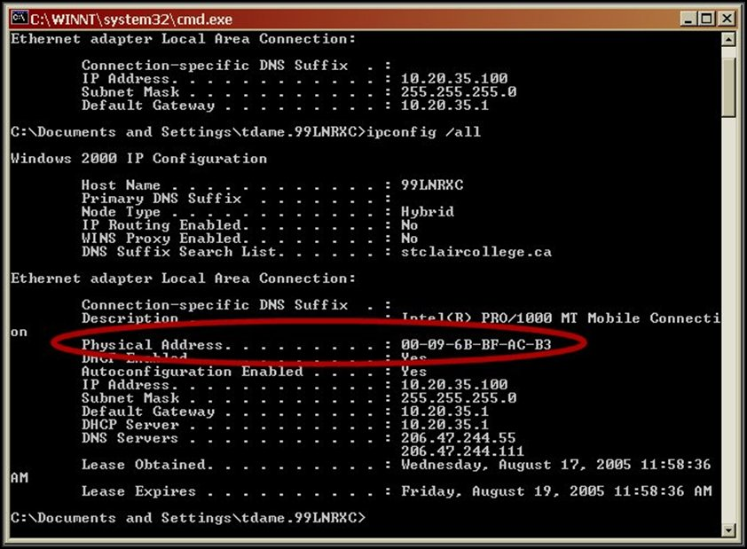
ipconfig /all
getmac
https://www.macvendorlookup.com/
https://macvendors.com/

Slide 33
5.1.3 Ethernet Unicast, Broadcast and Multicast
In Ethernet, different MAC addresses are used for Layer 2 unicast, broadcast, and multicast communications.

Slide 34
Ethernet Unicast
The process of sending a frame from one host to an individual host
For a unicast packet to be sent and received, a destination IP address must be in the IP packet header.
A corresponding destination MAC address must also be present in the Ethernet frame header.
The IP address and MAC address COMBINE to deliver data to one specific destination host.

Slide 35
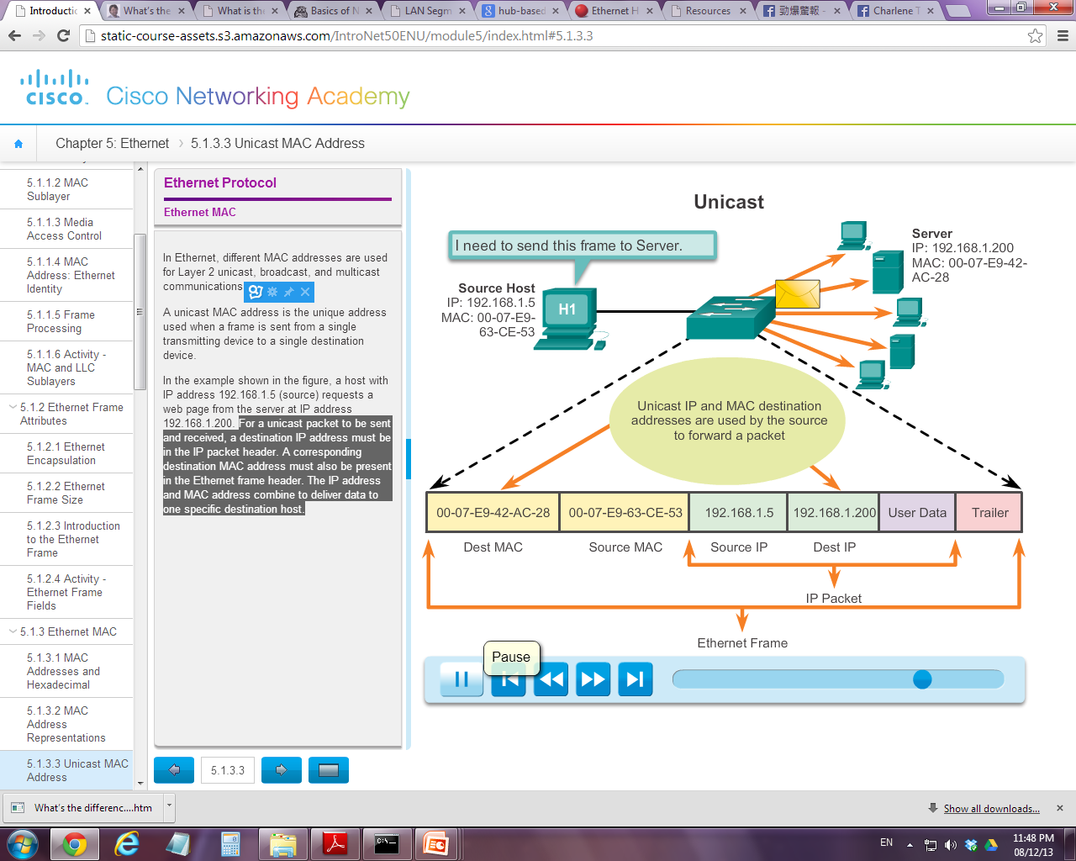

Slide 36
Ethernet Broadcast
The process of sending a frame from one host to ALL hosts in the network
A broadcast packet contains a destination IP address that has all ones (1s) in the host portion
The broadcast MAC address is 48 ones (1s) displayed as hexadecimal FF-FF-FF-FF-FF-FF

Slide 37
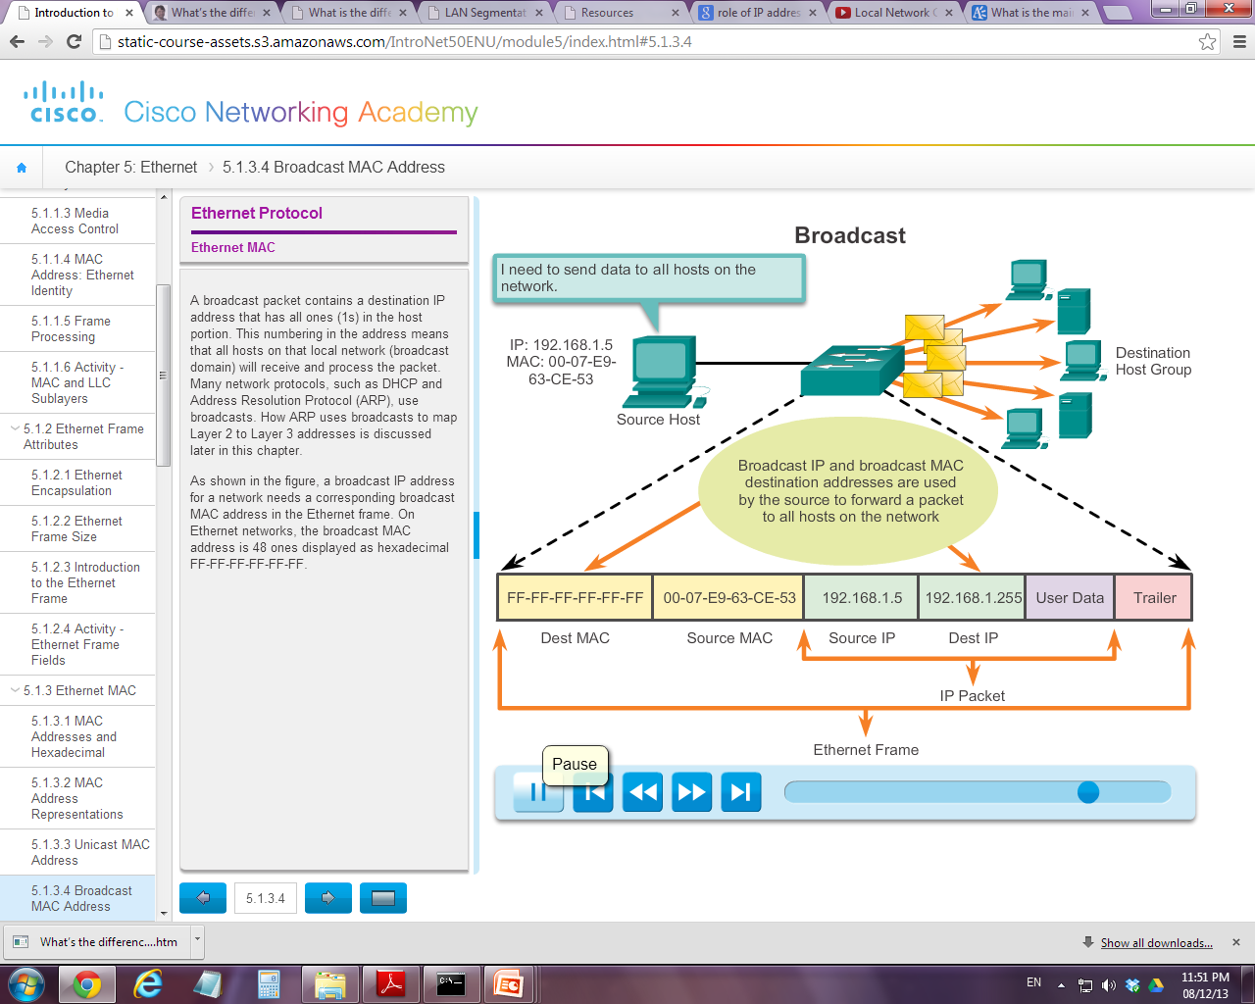

Slide 38
Ethernet Multicast
The process of sending a packet from one host to a SELECTED group of hosts
Devices that belong to a multicast group are assigned a special multicast group IP address. The range of IPv4 multicast addresses is 224.0.0.0 to 239.255.255.255
The multicast MAC address is a special value that begins with 01-00-5E in hexadecimal and the rest of the 24 bits come from converting the lower 24 bits of the IP multicast group address into 6 hexadecimal characters → 01-00-5E-xx-xx-xx

Slide 39
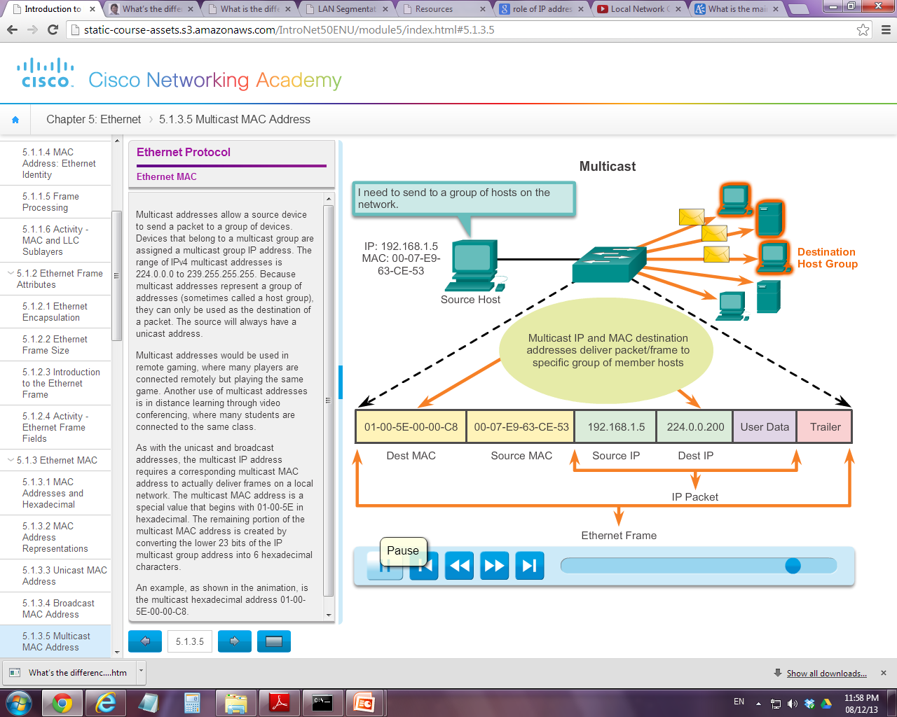

Slide 40
5.2 LAN Switches
An Ethernet switch is a Layer 2 device, which means it uses MAC addresses to make forwarding decisions.
Unlike hub which will broadcast the frame, Ethernet switch consults a MAC address table (which is stored in the RAM) to make a forwarding decision for each frame.

Slide 41
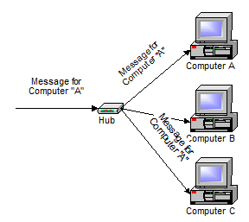
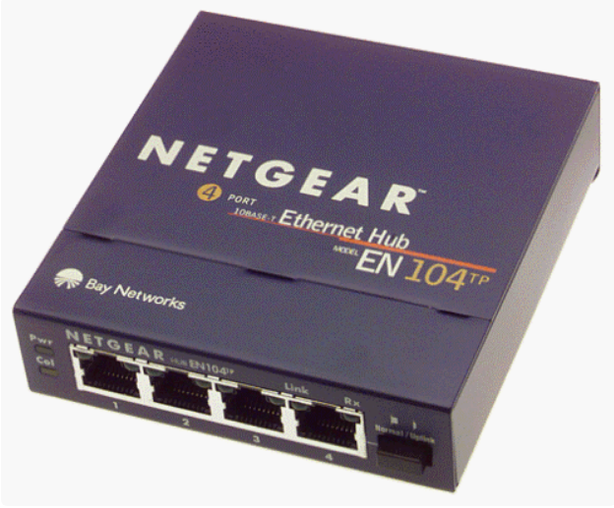

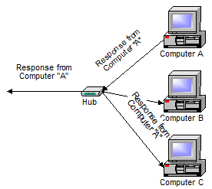
Hub

Slide 42
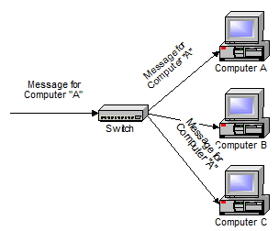
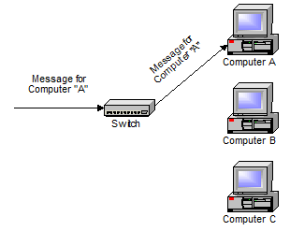

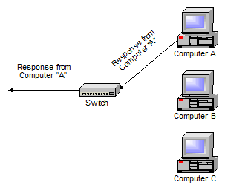
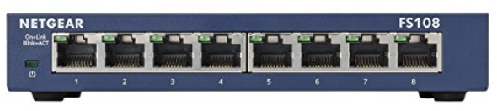
Switch learns MAC address of sender and saves to the lookup table
Switch forwards directly to Computer A
Switch
Switch learns MAC address of Computer A when it replies and saves to the lookup table

Slide 43
5.2.1 Learning MAC address
The switch dynamically builds the MAC address table by examining the source MAC address of the frames received on a port.
If the source MAC address does not exist, it is added to the table along with the incoming port number.
If the source MAC address does exist, the switch updates the refresh timer for that entry.

Slide 44
5.2.2 Filtering and Forwarding Frame
When forwarding a frame, the switch will look for a matched record in its MAC address table.
If the destination MAC address is in the table, it will forward the frame out the specified port.
If the destination MAC address is not in the table, the switch will forward the frame out all ports except the incoming port.

Slide 45
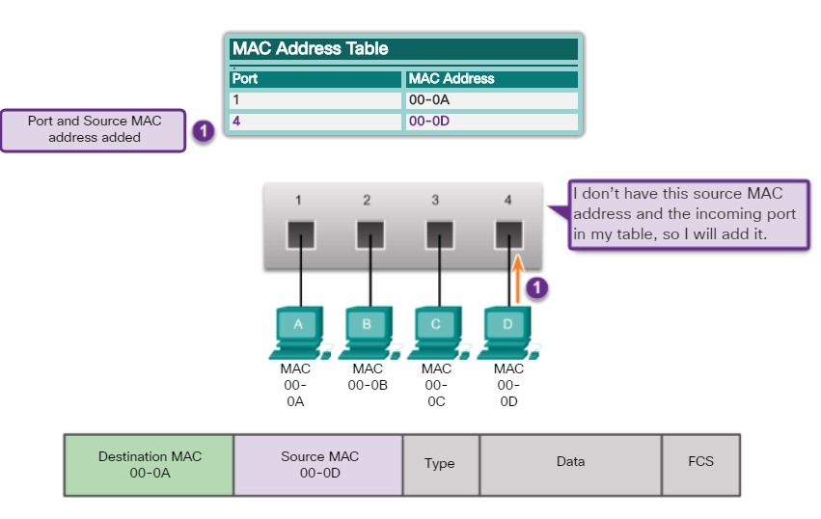
Frame Filtering and Forwarding
* MAC address is shortened

Slide 46
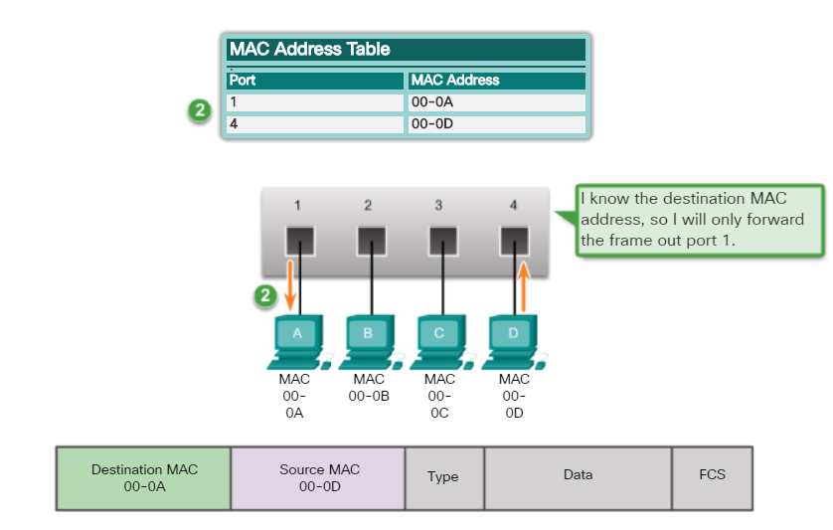

Slide 47
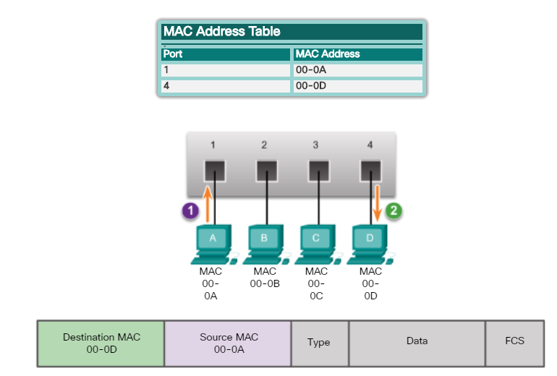
Switch will not perform broadcast
but unicast

Slide 48
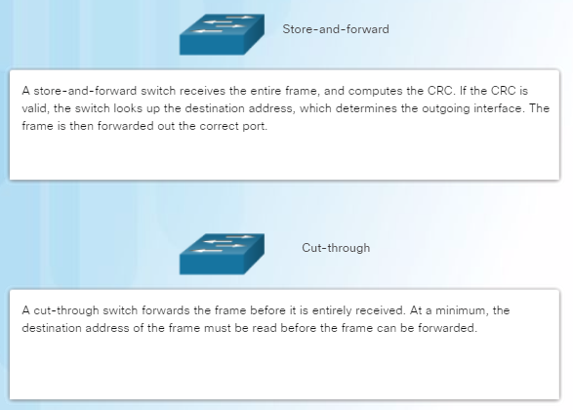
Frame Forwarding Methods on Cisco Switches
Switches use one of the following forwarding methods for switching data between network ports:

Slide 49
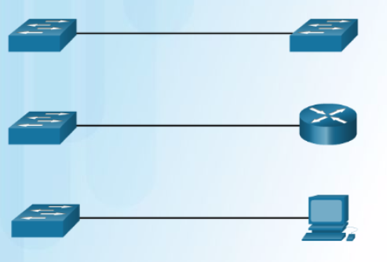
Auto-MDIX
Connections between specific devices such as switch-to-switch, switch-to-router, switch-to-host, and router-to-host devices, once required the use of specific cable types (crossover or straight-through).
Most switch devices now support the automatic medium-dependent interface crossover (auto-MDIX) feature. This is enabled by default on switches since IOS 12.2(18)SE.
When enabled using the mdix auto interface configuration command, the switch detects the type of cable attached to the port, and configures the interfaces accordingly.

Slide 50
5.3 Address Resolution Protocol
When a host want to send a frame to another host on the same LAN, the source host must know both the physical and logical addresses of the destination host.
To determine the destination MAC address, the device uses Address Resolution Protocol (ARP) to discover the MAC address of any host on the same local network.
Once the MAC address is obtained, the mapping between the IP and the MAC address will be stored in ARP table in the source host.

Slide 51
How ARP works?
The sending host will broadcast the ARP Request message (which contains the IP address of the destination device) to the entire LAN.
Every device on the LAN will examine the ARP Request to see if it contains its own IP address.
Only the device with the IP address contained in the ARP Request responds with an ARP Reply.
The ARP Reply includes the MAC address associated with the IP address in the ARP Request.

Slide 52
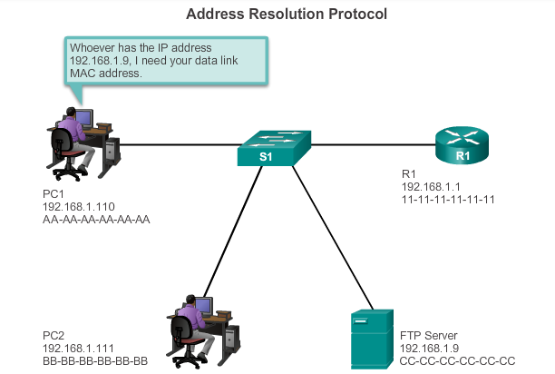

I don’t have the receiver MAC address. So I will activate ARP
sender
receiver

Slide 53
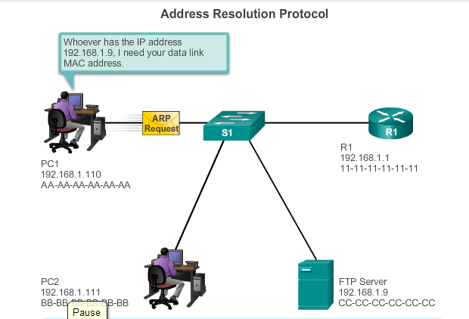
ARP is used to discover the destination
MAC address

Slide 54
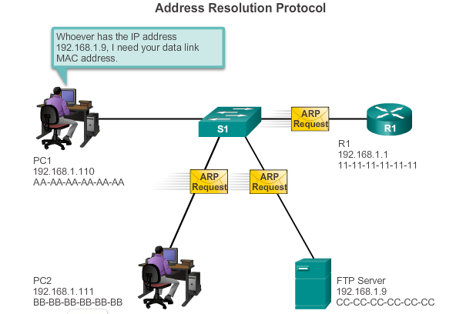
ARP request will be broadcasted to all
in the same network segment

Slide 55
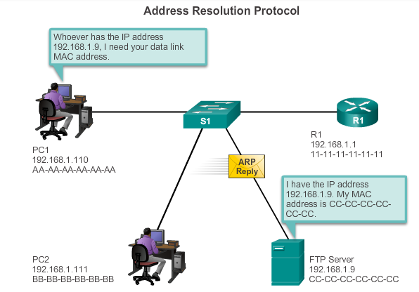
- Only the matched receiver will respond
with ARP reply that consists of its MAC address
- Frame can then be created

Slide 56
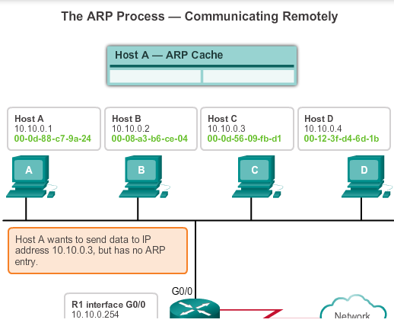
ARP Operation (Extra)

Slide 57
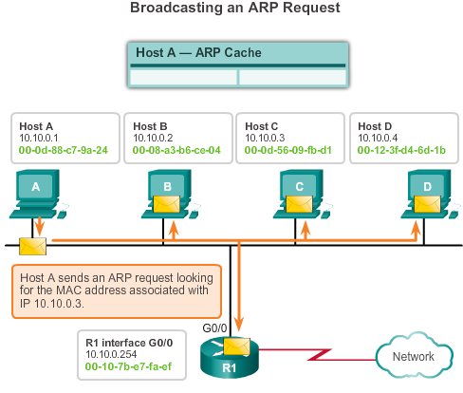
ARP ARP Functions/Operation

Slide 58
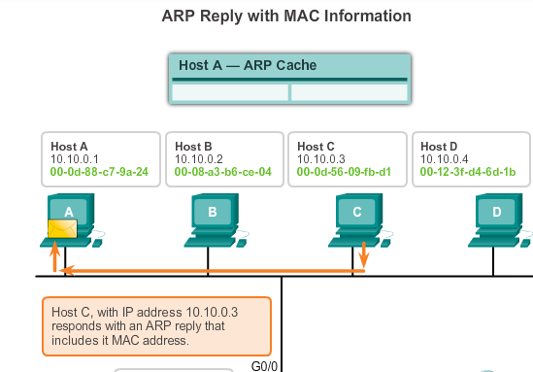

Slide 59
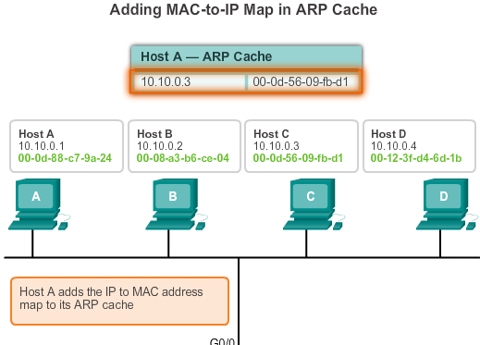

Slide 60
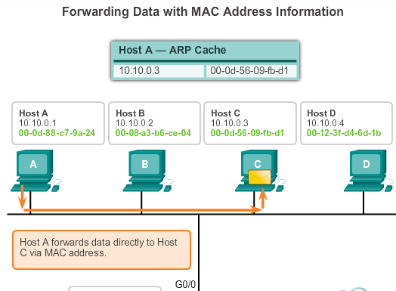

Slide 61
ARP Issues - ARP Broadcasting
ARP requests are received and processed by every device on the local network.
Excessive ARP broadcasts can cause some reduction in performance.
For example, if a large number of devices were to be powered up and all start accessing network services at the same time

Slide 62
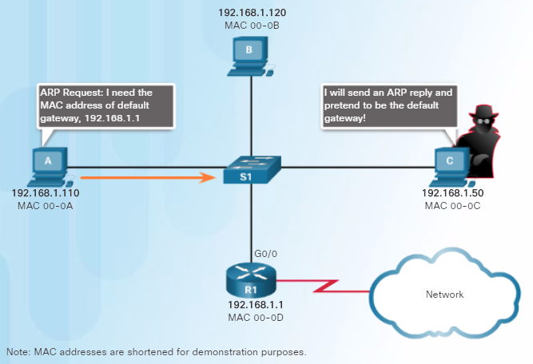
ARP Issues - ARP Spoofing
Attackers can respond to requests and pretend to be providers of services.
In the figure, host A requests the MAC address of the default gateway. Host C replies to the ARP request. Host A receives the reply and updates its ARP table. It now sends packets destined to the default gateway to the attacker host C.

Slide 63
Summary
Overview of Ethernet
Brief history of Ethernet
Ethernet media access control method (CSMA/CD)
Ethernet Frame structure
Ethernet MAC address
Ethernet Unicast, Broadcast, Multicast
LAN Switch
ARP

